Slide 1

CEIR GSMA - Training Manual

Slide 2

Agenda
GSMA Definition and Overview
Assumptions
Features
TAC
Global Black List
System Flow
Impact

Slide 3
GSMA - Definition
GSM Association (GSMA) represents the interests of mobile operator worldwide uniting more than 750 operators with almost 400 companies in the broader mobile ecosystem including handset and device makers, software companies, equipment providers and internet companies.
As the body authorized by 3GPP to allocate TAC (Type Allocation Code) for all GSM mobile devices identities globally, the GSMA is the source of authoritative and complete IMEI data.
GSMA provide two key services:
TAC Allocation
Black List Database
GSMA body is only body which has the IMEI and TAC database and hence it becomes very critical to integrate with GSMA for all the device TAC to be validated in order for effective regulation.

Slide 4
Overview

Slide 5
TAC - Overview
Type Allocation Code (TAC) is first 8 digits of the IMEI or MEID
All manufacturer / brand owner should get TAC allocated from GSMA before manufacturing the device
A TAC represents the complete device profile. This includes
Brand Name
Model Name
Device Type
OS Type
One TAC represents 1 million devices. So if company want to manufacturer 2 million Apple 7 devices, the company should request 2 TAC from GSMA

Slide 6
Global Black List - Overview
In a growing number of country, operator allow subscriber to to report a mobile phone or device as lost or stolen using device’s unique IMEI.
The operator can then block the device in their mobile network. This is called IMEI blacklisting
This blacklisted devices are provided to GSMA by mobile operators
GSMA provide a API to check if device (IMEI) is blacklisted or not.

Slide 7
API - Overview
TAC API
Call this API when a new TAC is found in the system
Input: TAC
Output: Status: Approved/Not Approved. If approved then also returns device profile. Key parameter include model name, brand name, OS Type, Device Type
Black List API
Call this API to find if IMEI is blacklisted or not
Input: IMEI
Output: Device Status (blacklist/Ok), Date of Blacklisting

Slide 8
API – Implementation
To avoid over usage of API, the following logic is implemented
Database | Description
Local TAC DB (LTAC) | When a new TAC is found in the system, TAC API is called. If TAC is found to be valid, then entry is made in this database. This entry is permanent
Local Invalid TAC DB (LiTAC) | When a new TAC is found in the system, TAC API is called. If TAC is found to be invalid, then entry is made in this database. This entry is temporary and is deleted after configurable period of time. This database is mutually exclusive from local TAC DB
Global Black List DB (GBS) | When a new IMEI need to be checked for blacklisting, Blacklist API is called. If device is found to be blacklisted, then entry is made in this database. This entry is temporary and is deleted after configurable period of time.

Slide 9
TAC API – Calling Sequence
Key Points
Invalid DB is cleaned after configurable period of time. Once cleaned and new TAC request is found in the system, TAC API is called.
In case the response is not received within configurable period of time, the system will keep retrying till the response is received.
Check TAC
Check local TAC DB
Yes
Return TAC details
No
Check local invalid TAC DB
Yes
Return TAC details
No
Call TAC API
Wait for Response
Update TAC DB / invalid TAC DB

Slide 10
Black List API – Calling Sequence
Key Points
Global Black list DB is cleaned after configurable period of time. Once cleaned and new IMEI need to be checked, Blacklist API is called.
In case the response is not received within configurable period of time, the system will keep retrying till the response is received.
Check IMEI
Check local Black list DB
Yes
Return IMEI details
No
Call Blacklist API
Wait for Response
Update Global Black list DB if required

Slide 11
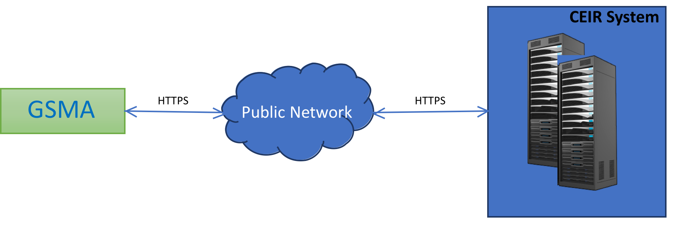
GSMA – CEIR Interface / Protocol
^{3.4 Integration Approach}
^{GSMA}
^{HTTPS Public Network HTTPS}
Diagram: Expected Integration of GSMA with CEIR system on HTTPs interface

Slide 12
Impact
As part of the work flow, two key critical DB is created, which is used for policy implementation
TAC Database
To check if the IMEI is valid. If IMEI contain a invalid TAC, then IMEI is considered as invalid
Device Reporting (Type of devices in network)
Black List Database
To ensure legal devices are used in the country
If device is blacklisted, it is considered as illegal.

Slide 13
Queries

Slide 14
Thank You

